Slide 1
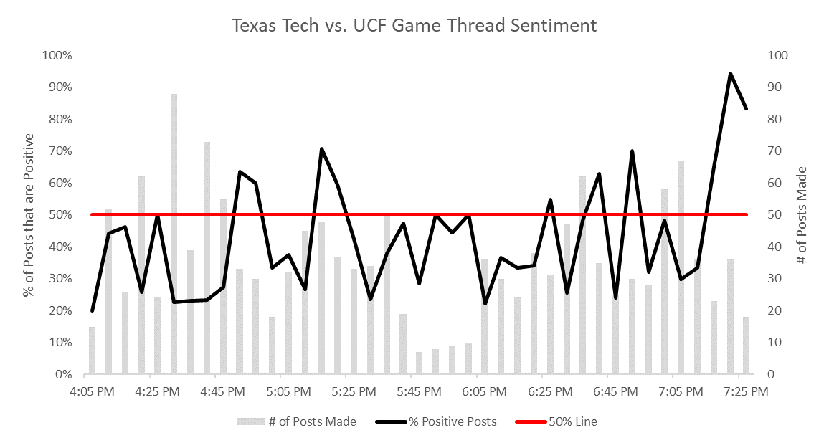
Dropped pass and failed 4th down conversion
Tech wins on missed extra point
Tech scores again
General frustration over playcalling and WR abilities
Tech scores

Slide 2
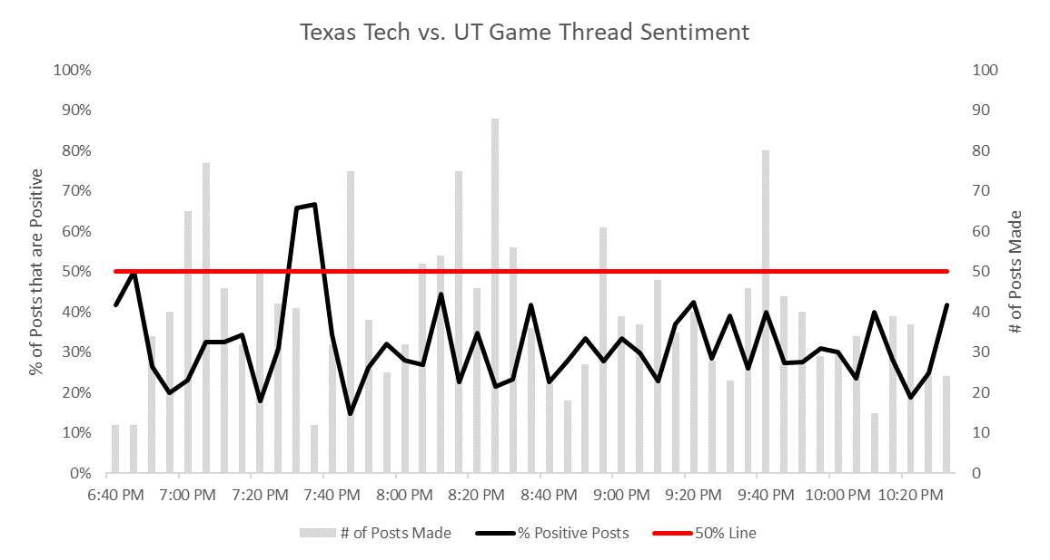
Tech touchdown
Pain and misery

